Slide 1


Transaction Management
Databases
Levente Erős – eros@db.bme.hu
Ruba AlMahasneh - mahasnehr@gsuite.tmit.bme.hu
Part one

Slide 2
Agenda
Basic terms
Transactions
Items
Operations
Schedule
Serializability of Schedules
Concurrency Control
Concurrency Possible Problems [Cases to avoid with Schedules-Problems with schedules]:
Scheduler
Concurrency Control Techniques
Deadlocks and Livelocks- Concurrent Processing
Deadlock management techniques
The Wait-for Graph
Livelocks
Transaction models
Simple Transaction Model
R/W model
Precedence graph
Two-phase locking
Granularity and Performance
States of a transaction

Slide 3
Transactions
Transaction: is a single execution of a single program. Composed of read /write operations. This program may be a simple query or multiple queries/statements expressed in one of the query languages.
Ques: Can several independent executions of the same program run in progress simultaneously ? give an example?
A transaction reads and/or writes data to and from the database, into private workspace, where all computations are performed.

Slide 4
Example: Money Transfer
If I want to withdraw some money from the ATM machine
Does withdrawing money contain a single step? Or multiple steps?
Executing these series of steps must meet some requirements.
Atomic; all steps carried out or none.
Consistent; only fully completed Trs. will affect the DB.
Isolated; Transactions are unaware of other transactions performing operations on the DB. The output of each transaction is not affected by any other Trs.
Durable; the effects of Trs are preserved in the DB.
Notes:
A: Atomic; all or none.
C: Consistent; only fully completed Trs. affect the DB.
I: Isolated; unaware of other transactions performing operations on the DB. Output of each transaction is not affected by any other Trs.
D: Durable; the results of Trs are preserved in the DB [committed].

Slide 5
Data Items
What is a data item?
Items : units of data to which access is controlled (size may vary, how?)
Give examples?
The database must be partitioned into items. Why?
The size of items used by system is often called its granularity. "fine-grained" system uses small items and "coarse-grained" one uses large items.
Notes:
An Item is a relation , some rows, bunch of data in the database
(data file, data file block, etc

Slide 6
Schedule
Schedule: the order in which the steps of the transactions (read, write and so on) are executed.
Scheduler: is a portion of the database system that arbitrates between conflicting requests. It controls access rights of transactions.
Notes:
It controls access rights of transactions using locks.

Slide 7
Schedules
Serial : one transaction at a time - no overlapping transactions
Non-Serial: overlapping transactions (most common in practice)
Non-Serial can be Serializable
A schedule said to be serializable IIF all its effects are equal to a serial schedule = serial equivalent exists
Notes:
a schedule is serializable if its effect is equivalent to that of some serial schedule.
The steps of any given transaction must appear in the schedule in the same order that they occur in the program(s) of which the transaction is being executed. A schedule is serial if all the steps of each transaction occur consecutively.

Slide 8
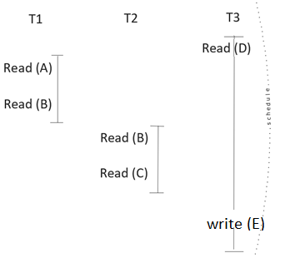
Serializability of Schedules
Ques:
Spot the serial and non serial schedule(s) parts.
Do serialized schedules exist in practice? Why?
Since Serial schedules are very unlikely in many practical cases→ Serial equivalent guarantees the same order as that obtained by running the same transactions serially in some order.
Notes:
Serial equivalent guarantees the same order as that obtained by running the same transactions serially in some order.
very important to mention that we assume that our schedules are serializable. That is the requirement for correctness

Slide 9
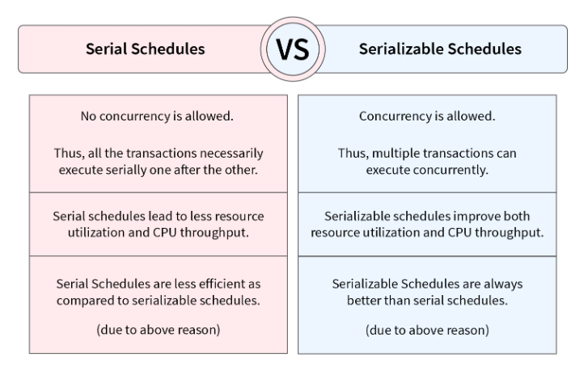

Slide 10
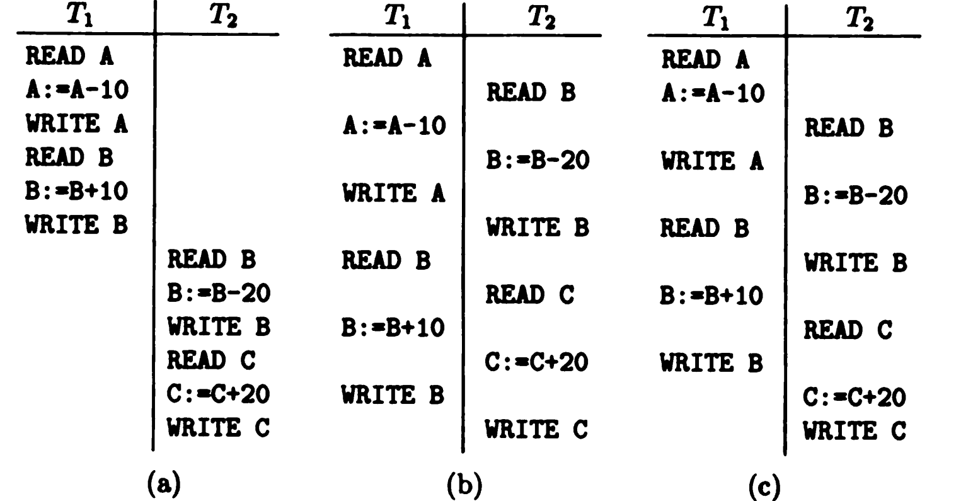
Serializability of Schedules

Slide 11
Discussion
It is possible to prevent the schedule of Figure section (c) from occurring by having all transactions lock before reading it.
In Figure section (a) we see serial schedule, and in Figure section (b) is serializable, but not serial, schedule. Figure section (c) shows non-serializable schedule.
Recall that we have defined schedule to be serializable if its effect is equivalent to that of serial schedule. However, it is not possible to test whether two schedules have the same effect for all initial values of the items, if arbitrary steps on the items are allowed, and there are an infinity of possible initial values. We assume that values cannot be the same unless they are produced by exactly the same sequence of steps.

Slide 12
Concurrency Control
It is the management of two simultaneous transactions to execute without conflicts between each other (such as in multiuser systems).
The simultaneous execution of transactions over shared databases can create several data integrity and consistency problems. How?
What advantages of concurrency control you can think of?

Slide 13
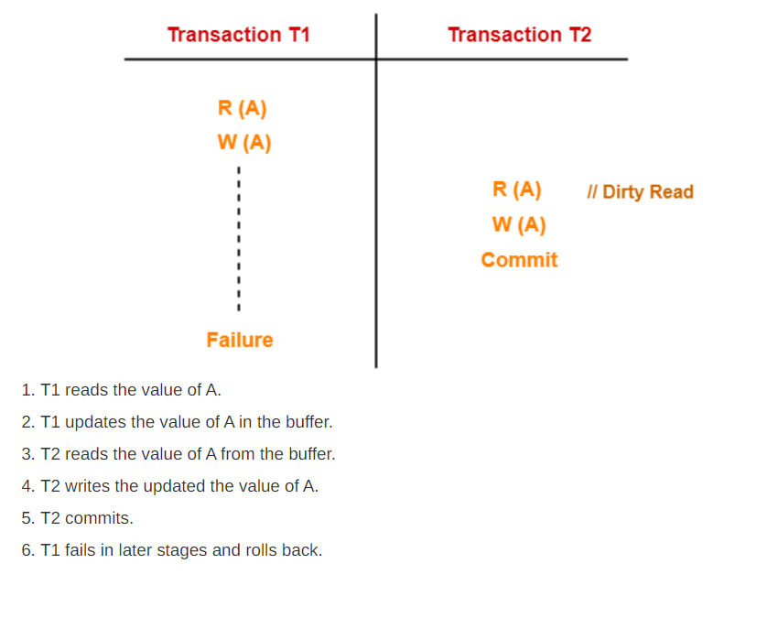
Concurrency Possible Problems [Cases to avoid with schedules-Problems with schedules ]:
Uncommitted Dependency or dirty read problem
Inconsistent retrievals

Slide 14
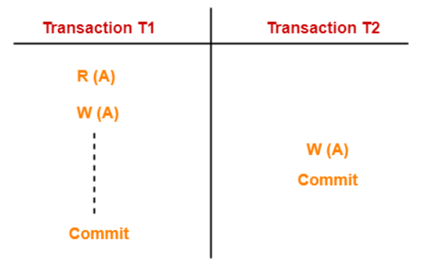
Lost Updates
T1 reads the value of A (= 10 say).
T2 updates the value to A (= 15 say) in the buffer.
T2 does blind write A = 25 (write without read) in the buffer.
T2 commits.
When T1 commits, it writes A = 25 in the database.
T1 over written value of A in the database.
Thus, update from T2 gets lost.

Slide 15
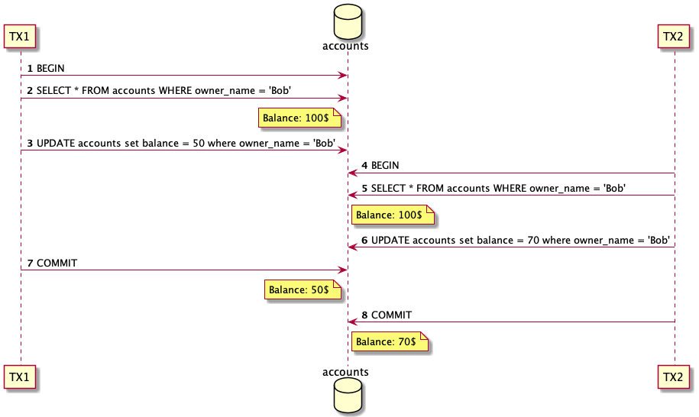
Lost Updates
Notes:
https://www.up-2date.com/post/lost-update

Slide 16
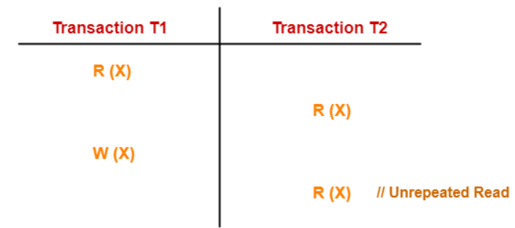
Unrepeatable Read
This problem occurs when a transaction gets to read unrepeated T1 reads the value of X (= 10 say).
T2 reads the value of X (= 10).
T1 updates the value of X (from 10 to 15 say) in the buffer.
T2 again reads the value of X (but = 15).
T2 gets to read a different value of X in its second reading.
T2 wonders how the value of X got changed because according to it, it is running in isolation.
Notes:
This problem occurs when a transaction gets to read unrepeated . i.e. different values of the same variable in its different read operations even when it has not updated its value.

Slide 17
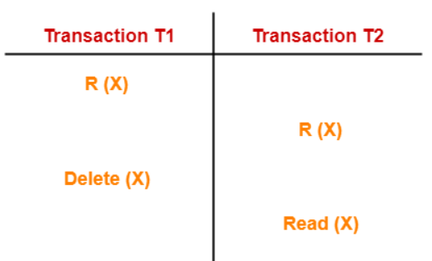
Phantom Read
T1 reads X.
T2 reads X.
T1 deletes X.
T2 tries reading X but does not find it.
T2 finds that there does not exist any variable X when it tries reading X again.
T2 wonders who deleted the variable X because according to it, it is running in isolation
Ques: How can we avoid all those problems ?

Slide 18
Conclusion –possible solution
Having a serial Schedule is the solution; where all the steps of each transaction occur consecutively.
Are serial schedules practical solution? Why ? What are other possible efficient solutions?
Notes:
schedule is serializable if its effect is equivalent to that of some serial schedule.

Slide 19
Concurrency Control Techniques – Scheduler
Lock: is access privilege to an item for a transaction, which the lock manager can grant or withhold from transaction. It stores the current locks in lock table, which consists of records (<data item>, <lock type>,<transaction> )
Ques: what is the meaning of record (I, L, T) ? → transaction T has lock of type L on item I
The lock manager finds locks on given items, insert lock records, and delete lock records, this will allow efficient management of locks.
Ques: what is the key for lock records? Why ?
Notes:
scheduler will maintain the serial equivalent for all events without hindering the efficiency

Slide 20
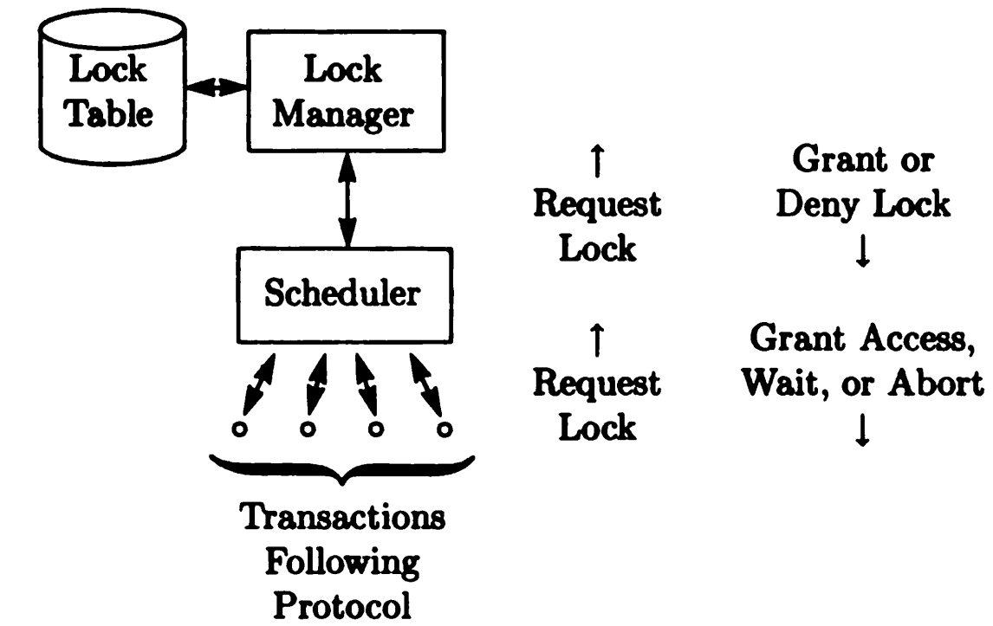
Concurrency Control -Relationship of the Lock Manager, Scheduler, and Protocol
Notes:
scheduler will maintain the serial equivalent for all events without hindering the efficiency
Protocol, is a set of rules on the sequences of atomic steps that a transaction may perform.

Slide 21
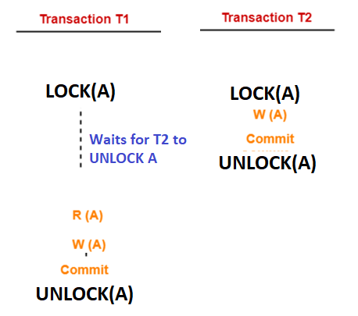
Concurrency Control Techniques
Locking : the transaction request to lock item(s) to perform some steps, after completion, the transaction releases the lock.
If an item was occupied when trying to lock it, the transaction will wait.
All locks must be released eventually.
How a lock solve the lost update problem here?

Slide 22
Deadlock- Concurrent Processing
Suppose we have two transactions T1 and T2 whose significant actions, as far as concurrent processing is concerned are:
T1: LOCK A; LOCK B; UNLOCK A; UNLOCK B;
T2: LOCK B; LOCK A; UNLOCK B; UNLOCK A;
Discuss : Suppose T1 and T2 begin execution at about the same time. T1 requests and is granted lock on A, and T2 requests and is granted lock on B. Then T1 requests lock on B, and is forced to wait because T2 has lock on that item. Similarly, T2 requests lock on and must wait for T1 to unlock A.

Slide 23
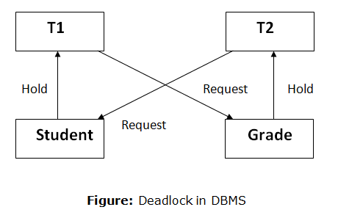
Deadlock
Neither transaction can proceed; each is waiting for the other to unlock needed item, so both T1 and T2 wait forever.
All activities come to a halt state and remain at a standstill.
It will remain in a standstill until the DBMS detects the deadlock and aborts one of the transactions.

Slide 24
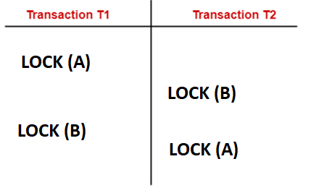
Deadlock Avoidance/Detection- Wait for Graph
Notes:
A deadlock occurs if each of two transactions (for example, T1, and T2) need exclusive use of some resource (a particular record) that the other already holds. Transaction T1 waits for the resource to become available.
If transaction T2 is not in a position to release it because it, in turn, is waiting on some resource held by T1, both are deadlocked and the only way of breaking the deadlock is to cancel/abort one of the transactions, thus releasing its resources.

Slide 25
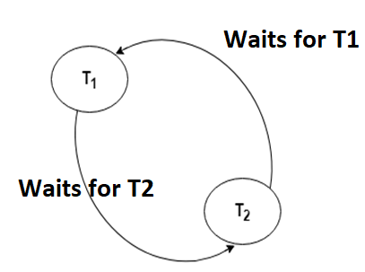
Deadlock Avoidance/Detection- Wait for Graph
Deadlock avoidance mechanism is used to detect any deadlock situation in advance. A method like "wait for graph" is used for detecting the deadlock situation but this method is suitable only for the smaller database.
The scheduler decides how to resolve this conflict , to release the deadlocks ( by aborting a transaction for example)
Notes:
The scheduler decides how to resolve this conflict , to release the deadlocks ( by aborting a transaction for example)
not serial is not a property for a transaction but a schedule which contains many transactions
not serial is not a property for a transaction but a schedule which contains many transactions
create serializable equivalent but we can never keep it serial due to performance issues but we have to find the serial equivalent
it is serializable is the goal and using locks is one of the methods by ensuring this srializabilithy

Slide 26
Deadlock- Possible Solutions
each transaction requests all its locks at once, and let the lock manager grant them all, if possible, or grant none and make the process wait, if one or more are held by another transaction.
Assign an arbitrary linear ordering to the items, and require all transactions to request locks in this order.
Notes:
Protocol, is a set of rules on the sequences of atomic steps that a transaction may perform.
The deadlock-avoiding strategy of requesting locks on items in some fixed order is a protocol.

Slide 27
Deadlock
Deadlock Prevention
Deadlock prevention method is suitable for a large database. If the resources are allocated in such a way that deadlock never occurs, then the deadlock can be prevented.
The Database management system (DBMS) analyzes the steps of the transaction whether they can create a deadlock situation or not. If they do, then the DBMS never allowed that transaction to be executed.
Deadlock Ignorance
Another approach to handling deadlocks is to do nothing to prevent them. By periodically examine the lock requests and see if there is deadlock.
Why this might be beneficial as a solution?
Notes:
Protocol, is a set of rules on the sequences of atomic steps that a transaction may perform.
The deadlock-avoiding strategy of requesting locks on items in some fixed order is a protocol.

Slide 28
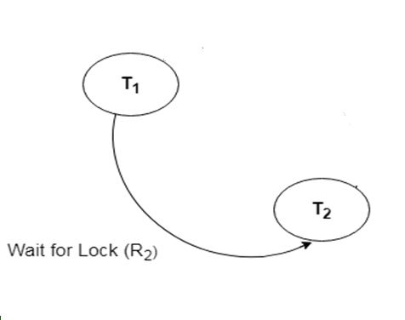
Live lock- Concurrent Execution
The system that grants and enforces locks on items cannot behave unpredictably.
Scenario: when T1 released its lock on A, the lock was granted to T2. What if while T2 was waiting, transaction T3 also requested lock on A, and T3 was granted the lock before T2? Then while T3 had the lock on A, T4 requested lock on A, which was granted after T3 unlocked A, and so on. It is possible that T2 could wait forever, since other transactions had lock on A, even though there are an unlimited number of times at which T2 might have been given chance to lock A.
Suggest Possible solutions for the live lock?
Notes:
If T1 is running for a long amount of time that no expected and T2 has to wait for a long time ( infinite loop for T1) so T2 waits infinitely
This first-come-first-served strategy eliminates livelocks- handelded by the scheduler

Slide 29
Transaction Models
Simple Transaction Model: one type of lock , two transactions can not lock the same item(s)
Precedence graph:
nodes represent the transactions.
Edges between T1 → T2 IIF there is a lock that T2 is granted and the last transaction who released that lock was T1 . There is an item that T1 unlocked and the first transaction to lock right afterwards (for the same item) was T2.
IIF Precedence is DAG (directed acyclic graph) ➔ the scheduling is serializable
Notes:
Wait for graph : it changes over time , and it refers to one point in time .
Precedent graph refers to the entire schedule , answers the question if the schedule is serializable or not .
A directed acyclic graph (DAG)
A topological ordering of a directed graph is an ordering of its vertices into a sequence, such that for every edge the start vertex of the edge occurs earlier in the sequence than the ending vertex of the edge.
A graph that has a topological ordering cannot have any cycles, because the edge into the earliest vertex of a cycle would have to be oriented the wrong way.

Slide 30
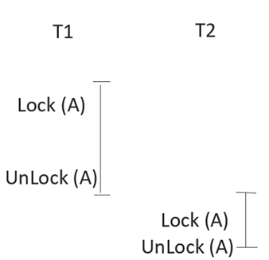
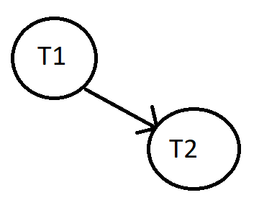
Precedence Graph

Slide 31
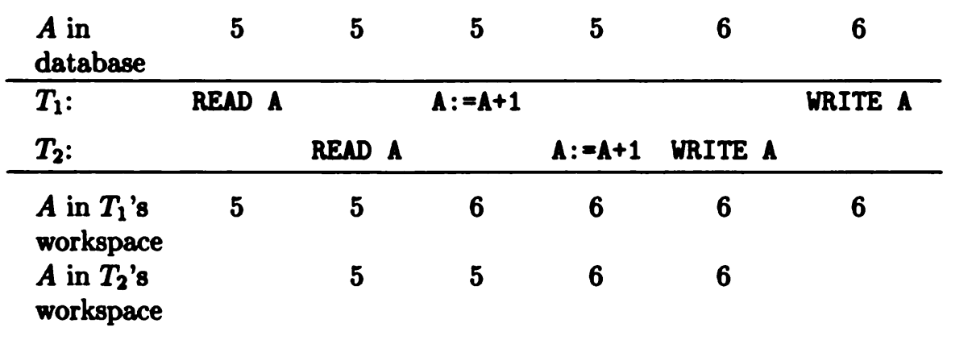
Discussion
How many programs are trying to modify record A. what are the possible real-life problems in this structure
Ques: What are the possible solution to prevent having two programs modifying the same record at the same time? Use the lock strategy we discussed earlier in the example below.

Slide 32
How Locks Control Concurrency When Transactions Execute in Parallel
Let us consider two transactions T1 and T2. Each Trs. accesses an item A, which we assume has an integer value, and adds one to A. The two Trs. are executions of the program P defined by:
P: READ A; A:=A+1; WRITE A; [the value of A exists in the database. P reads A into its workspace, adds one to the value in the workspace, and writes the result into the database]
Notes:
P471 book
We notice that although two transactions have each added 1 to A, the value of A has only increased by 1. This problem is serious if A represents seats
sold on an airplane flight, for example.
The most common solution to the problem represented by Example 9.1 is to provide a lock on A. Before reading A, a transaction T must lock A,
which prevents another transaction from accessing A until T is finished with A. Furthermore, the need for T to set a lock on A prevents T from accessing
A if some other transaction is already using A. T must wait until the other transaction unlocks A, which it should do only after finishing with A.

Slide 33
Possible Solution
The most common solution to the problem represented is to provide lock on A. Before reading A, transaction T1 must lock A, which prevents another transaction from accessing until T1 is finished with A.
The need for T1 to set lock on A prevents T2 from accessing A. T2 must wait until the other transaction unlocks A, which it should do only after finishing with A.

Slide 34
Remarks
Unlock command is executed by the transaction holding the lock.
Lock Manager: locks record for the transaction when it requests it for a specific item.
Each transaction will unlock any item it locks, eventually.
Notes:
Suppose again that T1 and T2 are two executions of P. If T1 begins first, it requests lock on A. Assuming no other transaction has locked A, the lock manager grants this lock. Now T1, and only T1 can access A.
If T2 begins before T1 finishes, then when T2 tries to execute LOCK A, the system causes T2 to wait. Only when T1 executes UNLOCK will the system allow T2 to proceed. As result, the anomaly CAN NOT occur; either T1 or T2 executes completely before the other starts, and their combined effect is to add to A.

Slide 35
THE TWO-PHASE LOCKING PROTOCOL
We want to avoid having a schedule that is not serializable , we should follow some rules → two phase locking
Two-phase locking:
requires that in any transaction, all locks precede all unlocks
each transaction releases a lock for the first time (the order of releasing is not important) before it receives the last lock.
( the point in between those two phases is called synchronization point→ when the transaction has received all its requested locks before releasing the first lock).
Notes:
we need to understand the conditions under which schedule is serializable is so that we can select combination of scheduler and protocol that together guarantee any schedule they allow is serializable.
In the model of this section, if transactions obey the two-phase protocol, then any legal schedule is serializable.
IIF the schedule is serializable then it will have a serial equivalent to it

Slide 36
THE TWO-PHASE LOCKING PROTOCOL
Transactions obeying this protocol are said to be two-phase; the first phase is the locking phase, and the second is the unlocking phase.
The schedule that uses 2PL is serializable schedule
T1
Lock (A)
Lock(B)
→→ synchronization point →→
unlock(B)
unlock(A)
Note: When the transaction unlocks an item in the second phase it can not lock ANY other item again
Notes:
2PL must happen in chunks, all locks at one phase and all unlocks in the second phase, they can not overlap [not 2PL]
When the transaction unlocks an item in the second phase it can not lock ANY other item again , since that phase is already over.
We use 2PL to ENSURE the schedule is serializable

Slide 37
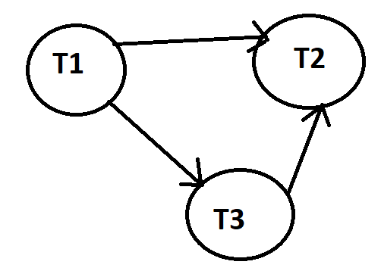
Serial equivalent from the precedent graph
Topological order : T2 ( it does not have a leaving edge) . T3, T1 == serial equivalent schedule of this graph → T2, T3, T1
In case of 2PL (since there might be many serial equivalents) ONE (since there can be many) serial equivalent is going to be the order of the synchronization points
[ie.according to the order of synchronization points].
Notes:
If a schedule is serializable THEN it will have a serial equivalent -→ we use the precedent graph to find that Serial equivalent .
T2 does not have an output edge ( edge that leads out) then we start with that
Can have multiple serial equivalent for the same schedule [In this case T2, T3, T1 has the same effect as your original schedule ]

Slide 38
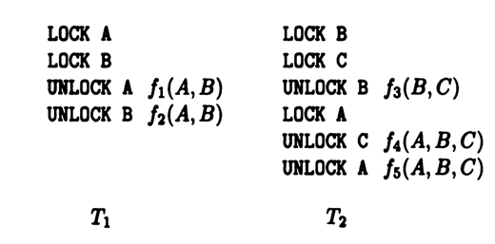
Which transaction is two-phase protocol and which is not ?

Slide 39
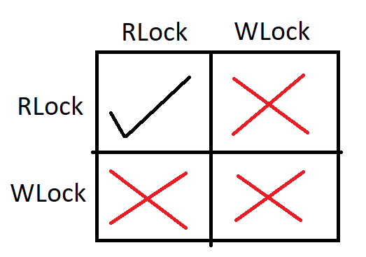
Control Concurrency when Transactions Execute in Parallel
Types of Locks
Shared Lock [Transaction can only read the data item values]
Exclusive Lock [Used for both read and write data item values]
Exclusive Lock [read/write lock Model]
Notes:
This gives us higher performance + better lock management system

Slide 40
Lock Based Protocol- Lock Manager
1. Shared lock:
It is also known as a Read-only lock. The data item can only be read by the transaction.
It can be shared between the transactions because when the transaction holds a lock, then it can't update the data on that data item.
2. Exclusive lock:
The data item can be both read and written by the transaction.
Multiple transactions do not modify the same data simultaneously.
How can we apply this concept to flight tickets booking process?
Notes:
For each item I , whether one or more transactions are reading or writing any part of I, the lock manager is the part of DBMS that forbids another transaction from gaining access to I, provided the type of access (read or write) could cause conflict

Slide 41
How Does items Granularity Affect Performance with Locks?
Choosing large granularity cuts down on the system overhead needed to maintain locks, since we need less space to store the locks, and we save time because fewer actions regarding locks need to be taken.
Small granularity allows many transactions to operate in parallel, since transactions are then less likely to want locks on the same items.

Slide 42
Brain Teaser
UPDATE Customers
SET ContactName = 'Alfred Schmidt', City= 'Frankfurt'
WHERE CustomerID = 1;
************************************************************
SELECT Orders.OrderID, Customers.CustomerName, Orders.OrderDate
FROM Orders INNER JOIN Customers ON Orders.CustomerID=Customers.CustomerID;
How would you choose the items in those two cases and why?
Hint: Consider best performance

Slide 43
Granularity
Rule of thump: proper choice for the size of an item is such that the average transaction accesses few items.
Assumption for simplicity: we shall assume that when part of an item is modified, the whole item is modified
Discuss
if the typical transaction (in relational system) reads or modifies one tuple, which it finds via an index, what would be the proper item?
If the typical transaction takes join of two or more relations, and thereby requires access to all the tuples of these relations, which item would you choose?
Notes:
it would be appropriate to treat tuples as items.
If the typical transaction takes join of two or more relations, and thereby requires access to all the tuples of these relations, then we would be better off treating whole relations as items. Discuss

Slide 44
Conclusion: To Achieve More Concurrency While Guaranteeing Correctness. What must be done?
every schedule of every collection of transactions is allowed if its effect happens to be equivalent to some serial schedule and forbidden otherwise.
Notes:
Schedulers and Protocols.
Used to eliminate
Livelock
Deadlock
Non-serializable behavior.
Deadlocks and non-serializability ?
Forcing given transaction to wait, for example, until lock it wants is available
Telling the transaction to abort and restart.

Slide 45
Is Abort Desirable or Not ? Why!
Forcing many transactions to wait for long periods may cause too many locks (waiting transactions might already have some locks).
deadlock causes many transactions to delay so long that the effect becomes noticeable for end users. ( Ex: the user standing at an ATM machine).
when deadlocks are inventible, the scheduler has no choice but to abort at least one of the transactions involved in the deadlock.
Notes:
Protocol, is a set of rules on the sequences of atomic steps that a transaction may perform.
The deadlock-avoiding strategy of requesting locks on items in some fixed order is a protocol.

Slide 46
Possible States of a Transaction Explained
1. Failed state
If any of the checks made by the database recovery system fails, then the transaction is said to be in the failed state.
Example: total mark calculation, can you explain how this might apply?
2. Aborted
If any of the checks fail and the transaction has reached a failed state then the database recovery system will revert to its previous consistent state [it will abort or roll back the transaction].
If a transaction fails in the middle, then all the executed operations are rolled back.
Notes:
Abort: Also known as "rollback". Aborting a transaction consists of ensuring that state of the database becomes as if the transaction had never begun. Any changes made by the transaction must be undone and we must ensure that those changes had no effect on any concurrently executing transactions.
When you abort a transaction, all database modifications performed under the protection of the transaction are discarded, and all locks currently held by the transaction are released. In this event, your data is simply left in the state that it was in before the transaction began performing data modifications.
Abort: Your operation is failed due to some reason, then DBMS rollback the operation into previous consistent state.

Slide 47
Possible States of a Transaction
After aborting the transaction, the database recovery module will select one of the two operations:
1. Re-start the transaction
2. Kill the transaction
3. Active state
The active state is the first state of every transaction (the transaction is being executed).
For example: Insertion or deletion or updating a record is done in the active state BUT all the records are still not saved (committed) to the database.

Slide 48
Possible States of a Transaction
4. Partially Committed
a transaction executes its final step, but the data is still not saved to the database.
Ex : total mark calculation, a final display of the total marks step is executed in this state.
5. Committed
if the transaction executes all its steps successfully. In this state, all the effects are now permanently saved in the database.

Slide 49
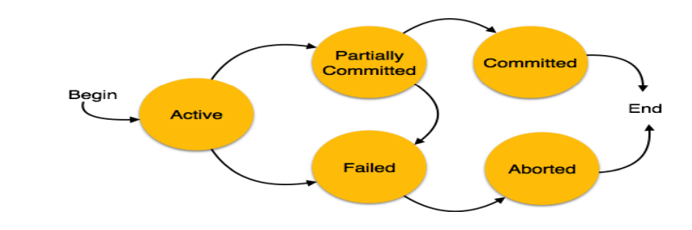
Possible States of a Transaction Explained

